Slide 1
Water Use Reporting in Texas
Kathy Alexander, Ph.D.
Technical Specialist
Water Availability Division
Texas Commission on Environmental Quality

Slide 2
Overview
Who needs to report water use?
Each holder of a water right is required to report their water use
Water use reporting is handled differently in different river basins
Non-Watermaster areas
Watermaster areas
No report is required to be filed by persons who divert water solely for domestic and livestock purposes.

Slide 3
Water Use Reporting – Outside a Watermaster Area
TWC § 11.031. ANNUAL REPORT. (a) Not later than March 1 of each year, each person who has a water right issued by the commission or who impounded, diverted, or otherwise used state water during the preceding calendar year shall submit a written report to the commission on a form prescribed by the commission. The report shall contain all information required by the commission to aid in administering the water law and in making inventory of the state's water resources.

Slide 4
Water Use Reporting - Other Requirements
Temporary permit holders – Once the temporary permit expires, the permittee must cease diversions and file a written report stating the amount of water and the date of cessation of use.
Within 10 days after beginning construction or installation of diversion and distribution facilities, a permittee shall file a statement showing that work was begun within the time limit allowed. Immediately upon completion of the project, a similar statement must be filed with the executive director showing that the work was completed within the specified time limitations.

Slide 5
Water Use Reporting- Penalties
A person who fails to file an annual report with the commission is liable for a penalty for each day the person fails to file the statement or comply with the request after the applicable deadline in an amount not to exceed:
$100 per day if the person is the holder of a water right authorizing 5,000 acre-feet or less per year
$500 per day if the person is the holder of a water right authorizing more than 5,000 acre-feet per year.

Slide 6
Water Use Reporting - Drought
Water right holders shall maintain water use information on a monthly basis during the months that a water rights holder uses permitted water.
During a drought or emergency shortage of water, or, in response to a complaint, the water right holder shall make the monthly information available upon request within a reasonable time frame.
Failure to provide the monthly information is also subject to penalties.

Slide 7
Water Use Reporting - Contracts
The purchaser shall submit annual written reports indicating the total amount of water diverted each month and the total amount diverted each week.
Purchasers diverting from the perimeter of a reservoir need to report only monthly diversions.
The supplier shall submit annual written reports indicating the total amount of water diverted and used each month for each purpose and the total amount released downstream each week to each purchaser under the storage water right specified in the contract.
A separate reporting of the amount of water estimated for transmission losses shall be made.

Slide 8
Water Use Reporting – Trends
Year | WUR Received | WUR Not Received
2011 | 3,231 or 74% | 1,112 or 26%
2012 | 3,073 or 71% | 1,271 or 29%
2013 | 4,262 or 81% | 988 or 19%

Slide 9
Water Use Reporting - Administration
On October 1, 2014, TCEQ’s Office of Water created the new Water Rights Compliance Assurance Team (WRCAT).
The WRCAT is part of the Water Rights Permitting and Availability Section.
The WRCAT is focusing on water use reporting, enforcement, changes of ownership, and the new surface water rights database.

Slide 10
Water Use Reporting - Process
Annual Water Use Reports are mailed the first week of January and are due March 1st.
A courtesy letter was sent in April to all water right owners that have not submitted an annual report.
84% (5,207) of the 2013 water use reports were submitted.
In August 2014 the WRCAT team began processing Notices of Violation (NOV) for water right owners that had not submitted an annual report.

Slide 11
Water Use Reporting - Actions
 | NOV mailed | resolved | remaining | resolved
August | 25 | 21 | 4 | 84%
September | 25 | 21 | 4 | 84%
October | 25 | 17 | 8 | 68%
November | 25 | 20 | 5 | 80%
December | 25 | 17 | 8 | 68%
January | 25 | 13 | 12 | 52%
February | 15 | 8 | 7 | 53%
March | 25 | 9 | 16 | 36%
April | 24 | 0 | 24 | 0%
Total | 214 | 126 | 88 | 59%

Slide 12
Watermaster Programs
What Watermasters Do:
Watermaster programs ensure compliance with water rights.
The Watermaster determines whether diversions can occur.
The Watermaster programs include staff “deputies” who perform regular field inspections of authorized diversions to ensure compliance with the water right.
TCEQ collects fees from all water right holders within the Watermaster’s jurisdiction in order to pay for the expenses of the Watermaster operations.

Slide 13
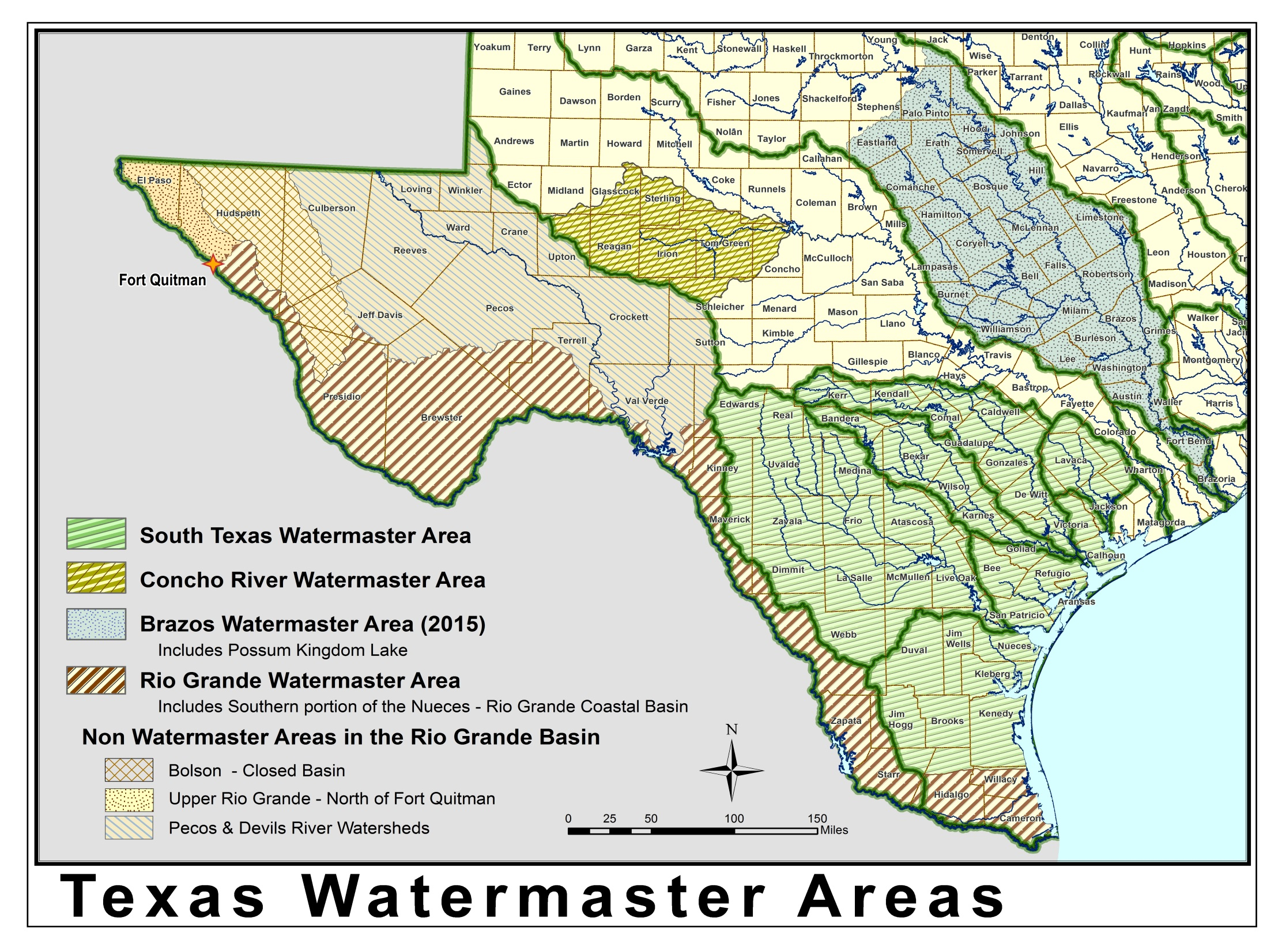
Watermaster Areas

Slide 14
Watermaster - Reporting Requirements
Notification – Declaration of Intent (DOI)
Pump Operation Reports
Annual Report

Slide 15
Notification – Declaration of Intent (DOI)
Diverter must submit a DOI to the Watermaster before diverting, transporting water, or making a dedicated release.
During times of lower flow, approval must be received from Watermaster staff before any diversion.
DOIs must include:
Account from which the water will be diverted;
The amount requested;
A diversion schedule;
The pump that will be used; and
The rate at which water will be diverted.

Slide 16
Watermaster - Pump Operation Reports
Within seven days after the close of the DOI period, each diverter that has submitted a DOI must submit a signed report with the actual amount of water diverted, transported, or released during the period.
The account will be modified as follows:
If the actual diversion is within 10% of the amount stated on the DOI, the amount deducted will be the actual amount diverted.
If the actual diversion is greater than 110% of the amount approved on the DOI, the amount deducted will be the actual amount diverted plus twice the amount greater than 110%.
If the actual diversion is less than 90% of the amount stated on the DOI, the amount deducted will be 90% of the stated amount.
When an account reaches zero, no more DOIs will be approved until the following year.

Slide 17
Watermaster - Annual Report
At the end of the year, the Watermaster office provides an annual water use report to each water right holder within the program.
Report accounts for all water use on an annual basis.

Slide 18
Questions?

